Slide 1


THE SYRIAN PRIVATE UNIVERSITY
FACULTY OF COMPUTER & INFORMATICS ENGINEERING
Health center management system
Prepared By:
Roaa kashour Tasneem Kadoor
Supervised by :
Dr. Akram Masouh
October 2026

Slide 2

Project Importance
· Practical Significance : A centralized web platform unifying clinical and administrative work, reducing manual effort and speeding up information retrieval. Native Arabic support and an intuitive interface ensure high user acceptance and quality of care.
· Academic Significance: A comprehensive practical application of software engineering methodologies (requirements elicitation, UML, database normalization) to a real-world health problem, bridging academic theory and production-ready software.

Slide 3

Project Goals
Clinical Workflow Optimization
Administrative and Financial Oversight
Patient Engagement and Education
Secure Access Control

Slide 4

Literature Review and Previous Work
First study: OpenMRS: Design and Implementation of an Open Source HER
Second study: GNU Health: Free Health and Hospital Information System
Third study: Commercial Medical Software vs. Custom Web-Based Systems

Slide 5

Comparison of previous studies
Limitation | Contribution | System
Complex setup, steep learning curve | Open-source EMR, modular, API-ready | OpenMRS
Linux/PostgreSQL dependency | Comprehensive EHR + finance modules | GNU Health
Commercial license, English-only | User-friendly, private-practice focused | ClinicMaster
1. Research Gap:
No existing system offers a lightweight, Arabic-native, academically-validated solution for mid-sized health centers with integrated patient feedback.
2. Our Innovation:
HCMS combines iterative software engineering, explicit requirement traceability (RTM), and patient-centric features (surveys, ratings, articles) in a cost-free, RTL-optimized package.

Slide 6

General Functional System Requirements
ID | General Functional Requirement
FR-G01 | The system must allow User Authentication & Role-Based Access Control (RBAC)
FR-G02 | The system must allow Clinical & Patient Data Management
FR-G03 | The system must allow Appointment Scheduling & Tracking
FR-G04 | The system must allow Administrative & Financial Oversight
FR-G05 | The system must allow Patient Engagement & Content Management

Slide 7

Non-Functional Requirements
ID | Description | Non-Functional Requirement
NFR-01 | Usability | The system interface must be simple, intuitive, and consistent across all modules to minimize user error.
NFR-02 | Localization | The system must fully support the Arabic language (RTL layout, Arabic fonts, and localized labels).
NFR-03 | Accuracy | The system must perform calculations (e.g., invoices, statistics) with 100% accuracy and validate all input data formats.
NFR-04 | Availability | The system must be accessible 24/7 via web browser without significant downtime during normal operations.
NFR-05 | Performance | Page load times and database query responses must remain under 2 seconds for standard operations.
NFR-06 | Security | User passwords must be encrypted (using secure hashing algorithms) before storage in the database.
NFR-07 | Security | Access to all pages must be protected by session validation; unauthorized access attempts must be redirected to login.
NFR-08 | Security | Role-Based Access Control (RBAC) must strictly enforce permissions; users can only access features relevant to their role.
NFR-09 | Scalability | The database schema and code structure must allow for future module additions without major refactoring.
NFR-10 | Integration | Data entered once (e.g., patient registration) must be automatically available across all related modules.

Slide 8

Functional requirements for the current project
Priority | ID | Requirement | Description
4 | REQ-043 | Change test request status | Change the status of an analysis request by the specialist.
4 | REQ-044 | Add a test request | Add an analysis request for a patient by a doctor.
4 | REQ-045 | Edit a test request | Modification of a request for additive analysis of a patient.
4 | REQ-046 | Enter test result | Entering the result of an analysis by the responsible specialist.
4 | REQ-047 | Add a medical record | Adding a new patient medical record.
4 | REQ-048 | Update medical record data | Updating a pre-listed medical record.
5 | REQ-049 | Add a diagnosis | Add a new diagnosis to the patient's condition by the doctor.
5 | REQ-050 | Update a diagnosis | A pre-added diagnostic update by the doctor.
5 | REQ-051 | Add an article | Adding a new health article.
5 | REQ-052 | Edit an article | Edit a previously added article.
5 | REQ-053 | Delete an article | Delete a previously added article.
5 | REQ-054 | Change article status | Changing the status of an article (available, hidden).

Slide 9
Development Methodology
Phase I: Reference Study & Requirements Elicitation (Weeks 1-2): Literature review, stakeholder analysis, and formal documentation of REQ-001 to REQ-054.
Phase II: Iteration 1 - Core Clinical Modules (Weeks 3-4): Implementation of patient record viewing and initial clinical workflows.
Phase III: Iteration 2 - Scheduling & Tracking (Weeks 5-6): Appointment booking, modification, and real-time status tracking.
Phase IV: Iteration 3 - Content & Feedback (Weeks 7-8): Health articles, survey deployment, and service rating mechanisms.
Phase V: Iteration 4 - Administrative & Financial (Weeks 9-10): Department lifecycle management, invoice generation, and reporting.
Phase VI: Iteration 5 - Advanced Clinical & Integration (Weeks 11-12): Final integration of laboratory test requests (REQ-042 to REQ-046), advanced medical records, and cross-module synchronization.
Phase VII: Documentation & Validation (Weeks 13-16): Comprehensive technical writing, UML/ERD finalization, test case execution, and academic report compilation.

Slide 10
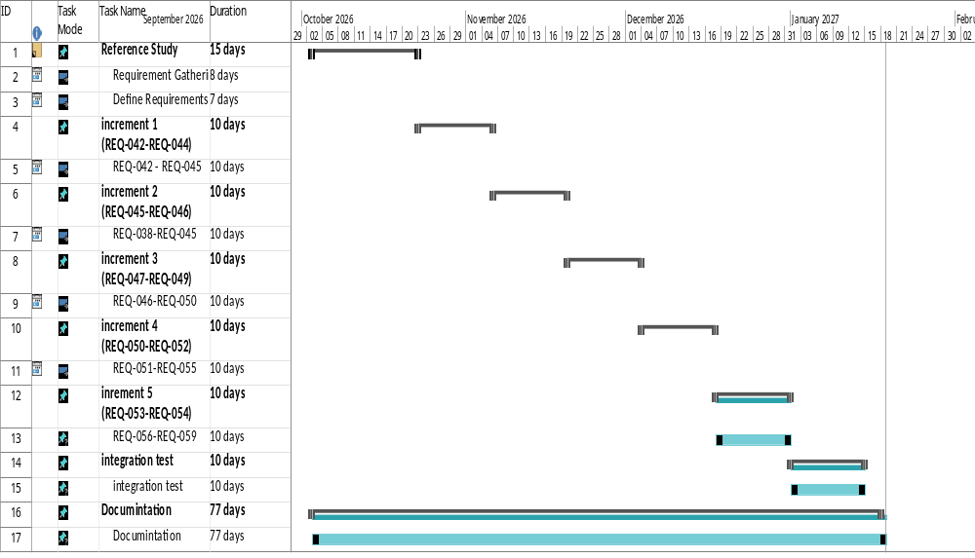
Project Plan (Gantt Chart)

Slide 11
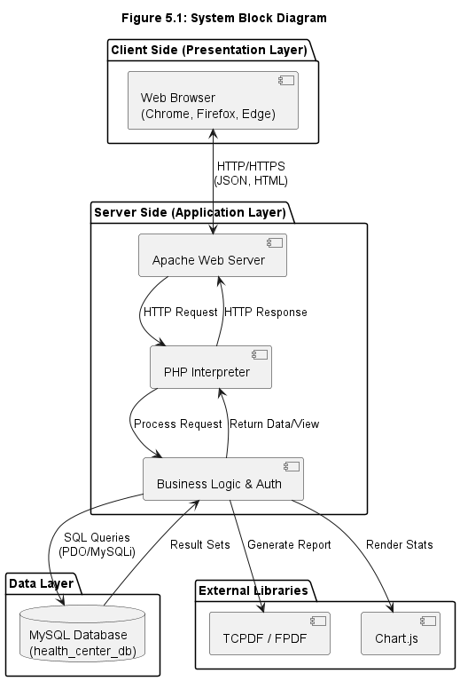
System Architecture

Slide 12
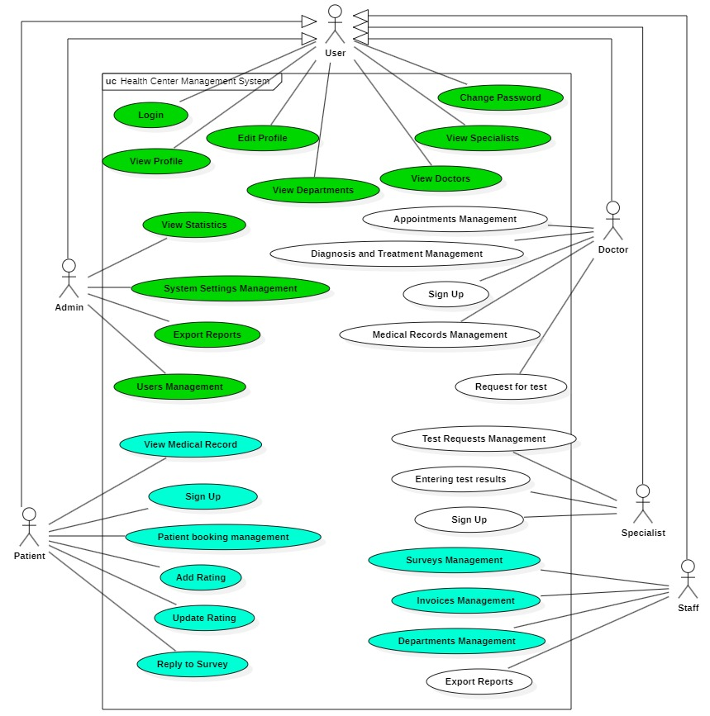
Use Case Diagram
Semester
Grad 1
Grad 2

Slide 13
Use Case Description
ID | REQ-054
Use case | Change article status
Brief description | Changing the status of an article (Available, Hidden)
Actors | Doctor, Specialist
Previous conditions | - Login - Article exists
Subsequent terms | - Successful completion of the operation
The main flow | When the user views the articles list, the system displays the status toggle for each article. The user changes the status (from Available to Hidden, or vice versa). The system immediately updates the status in the database. Hidden articles are no longer visible to patients.
Alternative flow | - None — status change is always permitted.

Slide 14
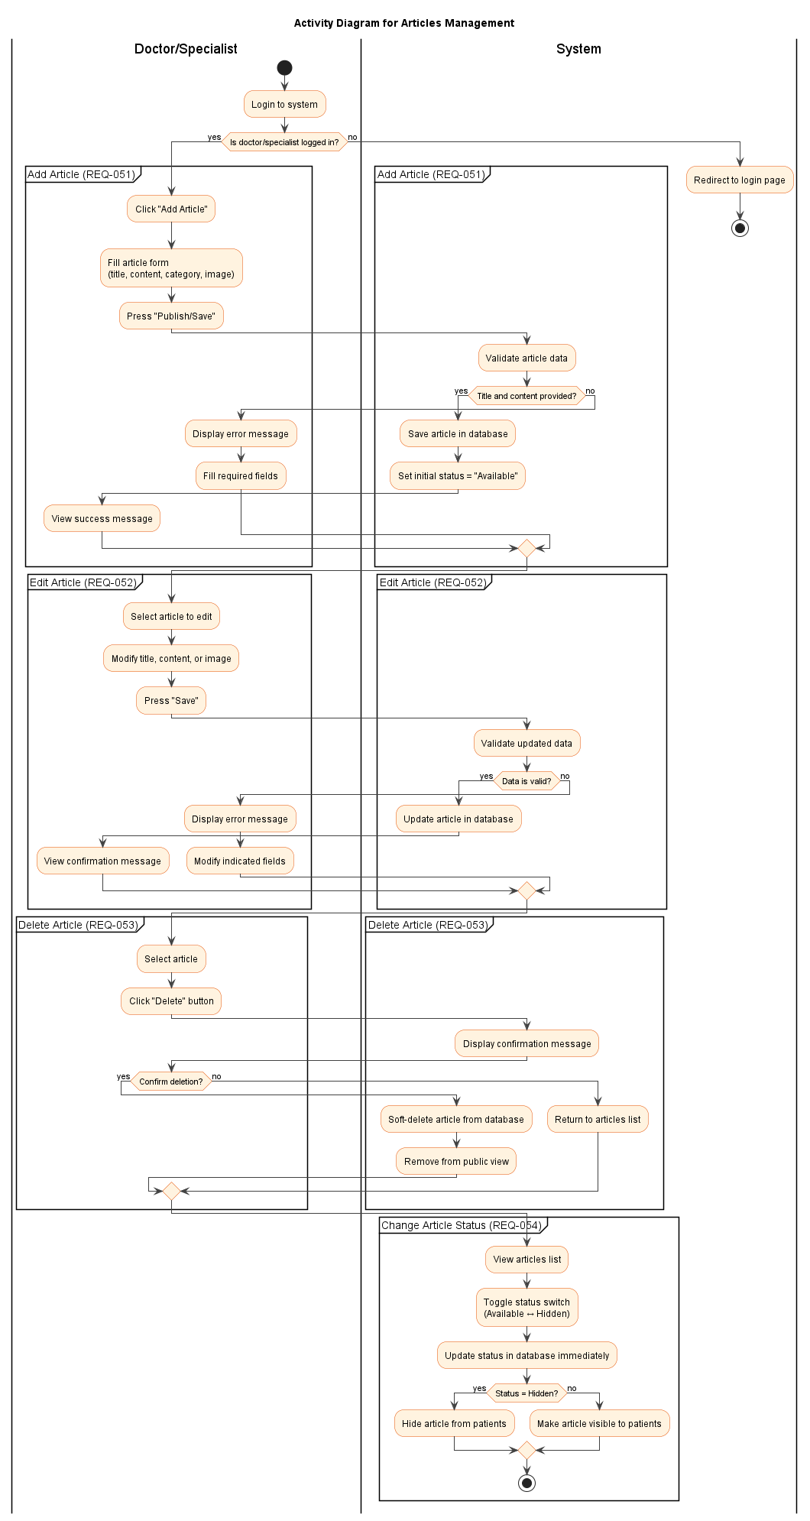
Activity Diagram

Slide 15
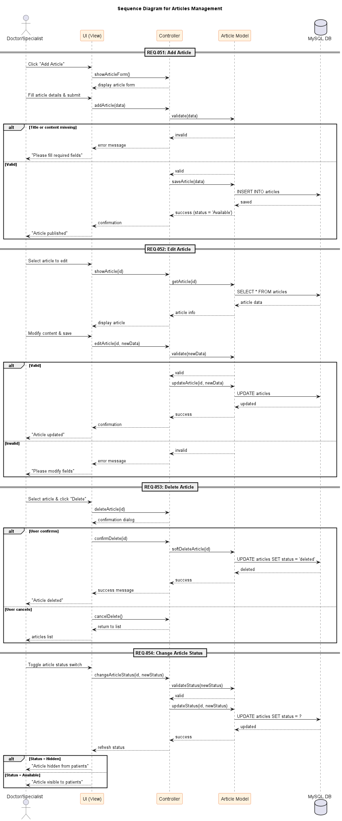
Sequence Diagram

Slide 16
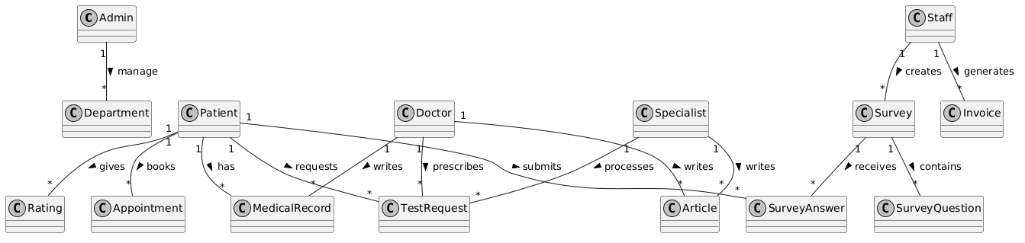
Class Diagram

Slide 17
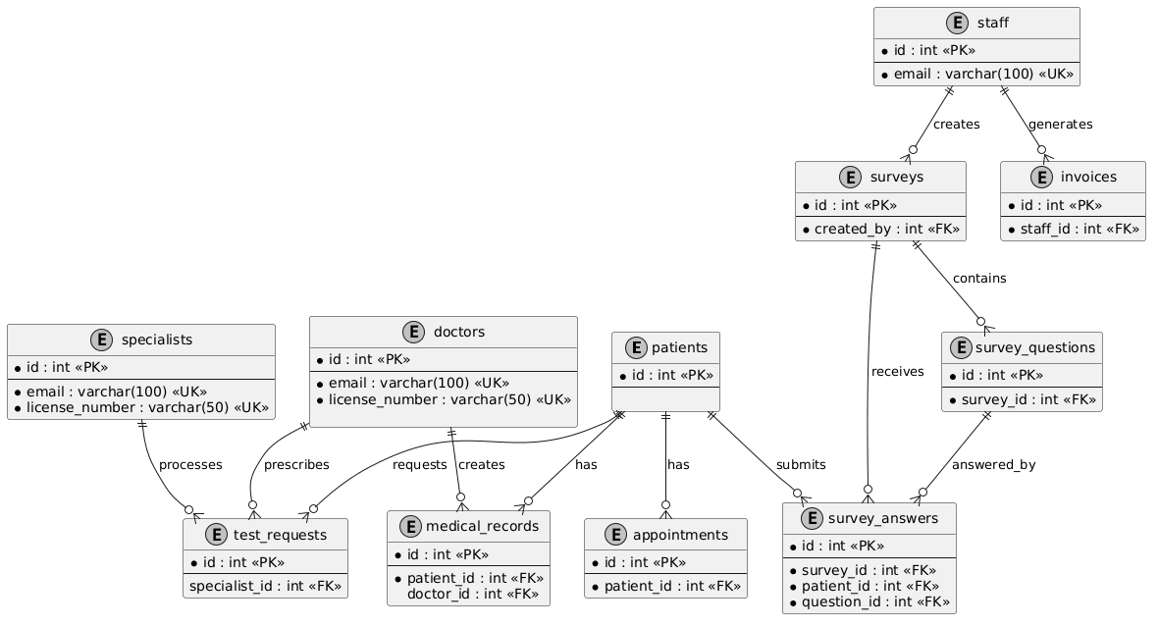
ERD

Slide 18
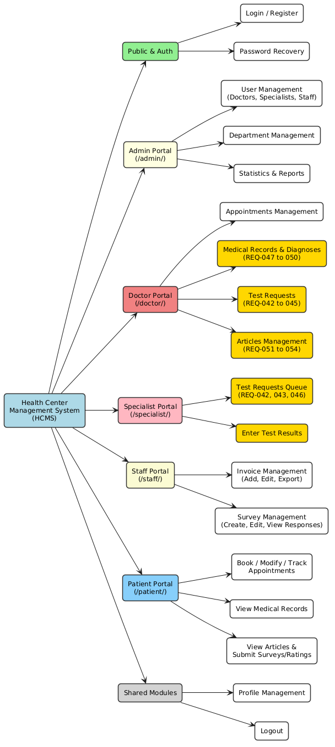
Sitemap

